Slide 1
Recap of intention
Compare results from 2 problems without investment
Original full year timeseries vs clustered timeseries
Reconstructed full year from clusters by repetition
Look for predictors of investment accuracy in difference metrics
In the past days, I built a framework to make this comparison easy by using single valued metrics for each clustering method, and number of clusters

Slide 2
Considered metrics
Original
Curtailment (summed absolute value of difference per hour)
Line flows (summed absolute value of difference per hour, per line)
Network utilization > 0.85 (summed absolute value of difference per hour, per line)
Extra
Overall cost components (Generation operating cost, .. )

Slide 3
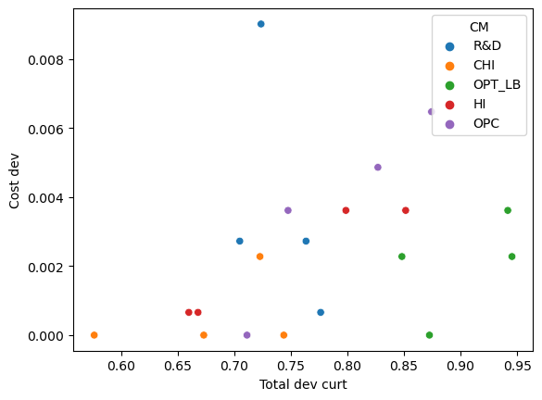
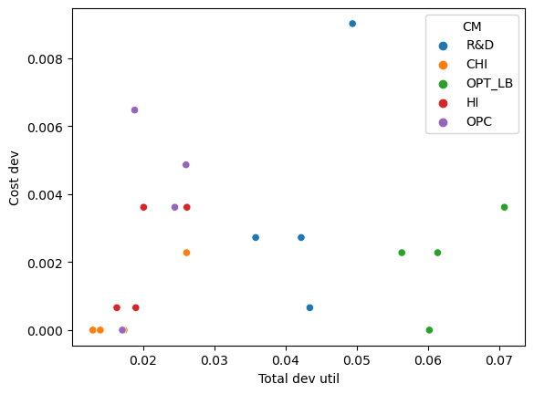
Results RTS24_mod1

Slide 4
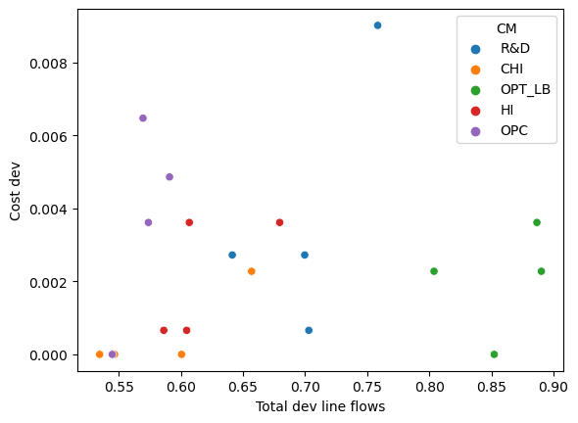
Results RTS24_mod1

Slide 5
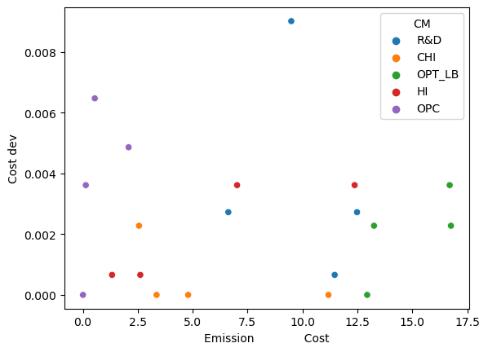
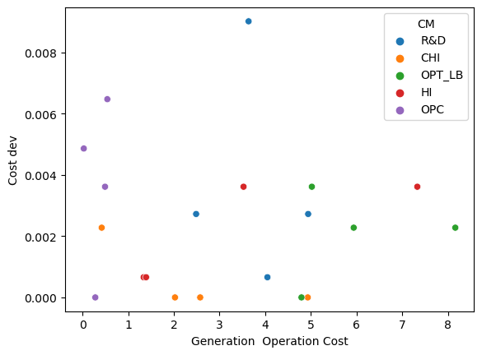
Results RTS24_mod1

